Slide 1
Economics and Business
HASSSA Conference 2017

Slide 2
Economics and Business Skills
Questioning and research
Develop questions about an economic or business issue or event, and plan and conduct an investigation or project (ACHES021)
Gather relevant data and information from a range of digital, online and print sources (ACHES022)
Interpretation and analysis
Interpret data and information displayed in different formats to identify relationships and trends (ACHES023)
US election, Donald Trump, https://getkahoot.com/, Australian election http://results.aec.gov.au/20499/Website/HouseDivisionalResults-20499.htm
Economic reasoning, decision-making and application
Generate a range of alternatives in response to an observed economic or business issue or event, and evaluate the potential costs and benefits of each alternative (ACHES024)
Apply economics and business knowledge, skills and concepts in familiar and new situations (ACHES025)
Communication and reflection
Present evidence-based conclusions using economics and business language and concepts in a range of appropriate formats, and reflect on the consequences of alternative actions (ACHES026)
Business Plan

Slide 3
Economics and Business Knowledge and Understanding Year 7
The ways consumers and producers interact and respond to each other in the market (ACHEK017)
Chair, Business Plan, http://www.nytimes.com/2012/01/27/opinion/apple-in-china-has-iorwell-arrived.html
Why and how individuals and businesses plan to achieve short-term and long-term personal, organisational and financial objectives (ACHEK018)
Business Plan
Characteristics of entrepreneurs and successful businesses (ACHEK019)
Entrepreneur photographs, life stories, YouTube videos, BBC
Why individuals work, types of work and how people derive an income (ACHEK020)
Investing, Work text

Slide 4
Economics and Business Knowledge and Understanding
Year 8
The ways markets in Australia operate to enable the distribution of resources, and why they may be influenced by government (ACHEK027)
Right Bite and healthy eating policies, excursion
The traditional markets of Aboriginal and Torres Strait Islander communities and their participation in contemporary markets (ACHEK028)
The rights and responsibilities of consumers and businesses in Australia in terms of financial and economic decision-making (ACHEK029)
text
Types of businesses and the ways that businesses respond to opportunities in Australia (ACHEK030)
business operation
Influences on the ways people work and factors that might affect work in the future (ACHEK031)
text

Slide 5
Economics and Business Knowledge and Understanding
Year 9
Australia as a trading nation and its place within the rising economies of Asia and broader global economy (ACHEK038)
Map and population, www.abs.gov.au, Brexit, Donald Trump
Why and how participants in the global economy are dependent on each other (ACHEK039)
excursion, Fortescue Metals www.asx.com.au, slavery www.acrath.org.au
Why and how people manage financial risks and rewards in the current Australian and global financial landscape (ACHEK040)
Scams
The nature of innovation and how and why businesses seek to create and maintain a competitive advantage in the market, including the global market (ACHEK041)
going offshore for cheaper labour, slavery www.acrath.org.au, social media
The changing roles and responsibilities of participants in the Australian or global workplace (ACHEK042)
Work text, Fair Work Commission

Slide 6
Economics and Business Knowledge and Understanding
Year 10
Indicators of economic performance and how Australia’s economy is performing (ACHEK050)
www.abs.gov.au, text
The links between economic performance and living standards, and how and why variations exist within and between economies (ACHEK051)
www.abs.gov.au, text
The ways that governments manage economic performance to improve living standards (ACHEK052)
World Bank Report, CIA website, text, https://www.youtube.com/watch?v=gMYNfQlf1H8
Factors that influence major consumer and financial decisions and the short- and long-term consequences of these decisions (ACHEK053)
Loans text
The ways businesses respond to changing economic conditions and improve productivity through organisational management and workforce management (ACHEK054)
www.abs.gov.au, text

Slide 7
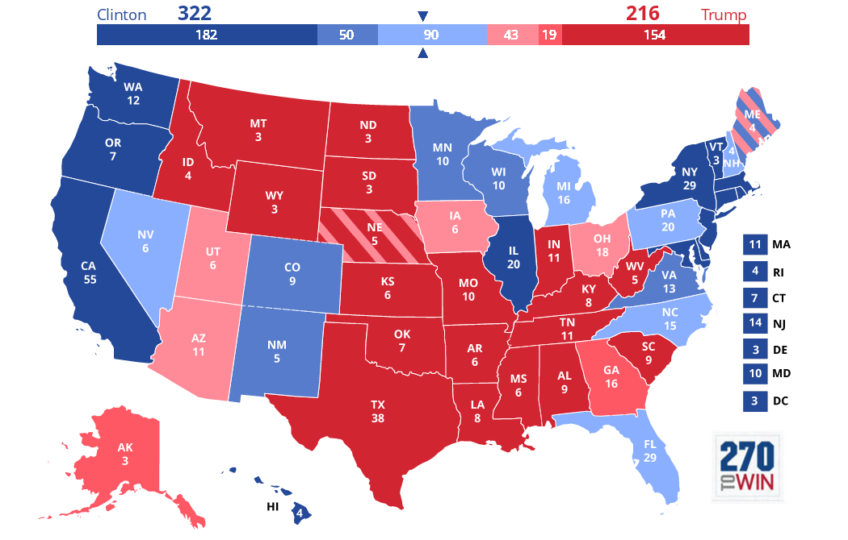
https://heatst.com/politics/hillary-clinton-might-be-winning-the-war-but-donald-trump-is-winning-the-battle-of-the-brands/

Slide 8
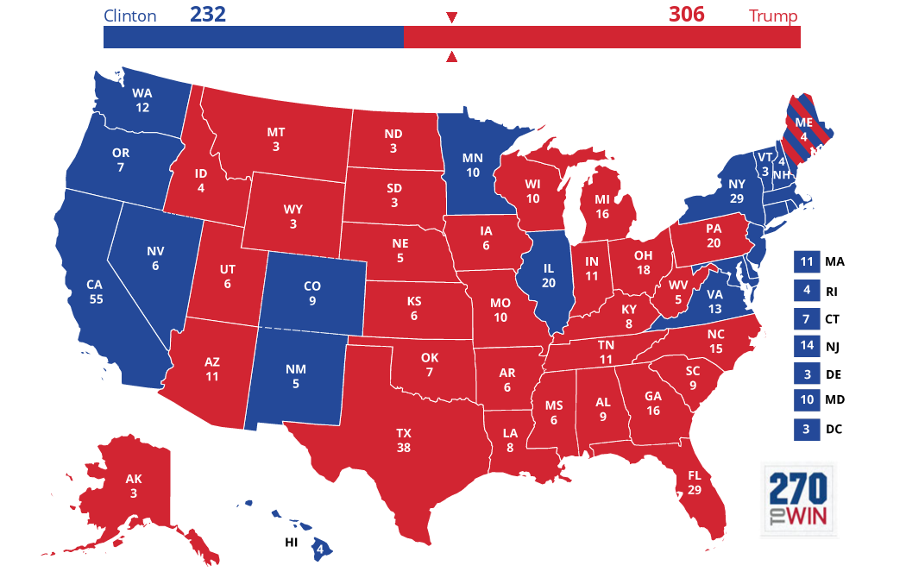

Slide 9
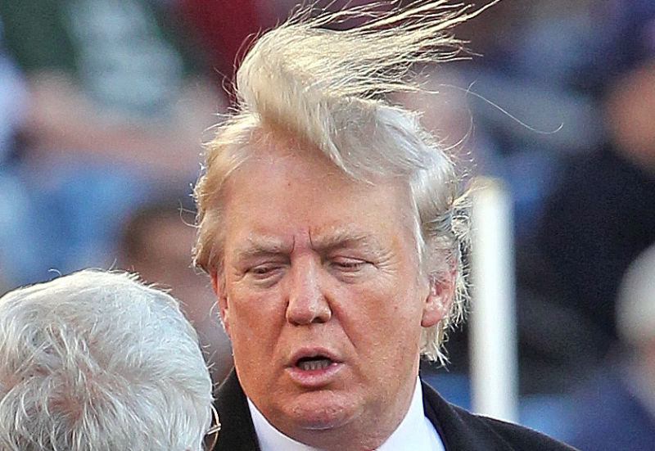
The End

Slide 10
By Ken Danieli|3:35 pm, October 12, 2016
The talking heads and political pundits are baffled this election season. To paraphrase the former Secretary of State, given all the media derision for Donald J. Trump and cheerleading for Hillary Clinton, why ISN’T she 50 points ahead, you might ask?
Even in view of the highly embarrassing Trump-Billy Bush NBC video leak last week, Hillary is still not ahead to the extent her supporters anticipated she would be at this point.
–– ADVERTISEMENT ––
The two leading candidates have crafted their marketing messages quite differently from each other this year in pursuit of the White House, and it’s for that reason that Mrs. Clinton doesn’t have the 50-point lead she says she deserves.
In marketing, the most successful brands position themselves with messages that are rooted in product truths. The best brands stand for something that’s authentically demonstrable about the product. A set of physical attributes deliver a set of benefits to consumers. From there a strong brand decides what positioning message will convey those benefits.
Ad campaigns and other communications are executions against the positioning and can vary over time but should deliver a consistent greater message, deeply rooted in benefits that are relevant to consumers, and which emanate from true, innate physical attributes.
Just about everyone in the country, whether they support The Donald or loathe him, could likely tell you that Trump’s campaign slogan is “Make America Great Again.”
That’s because he’s been using it consistently and relentlessly, in every medium, since he announced his campaign in June 2015. Trump realized that phrase, which is far from original (Ronald Reagan used it and even Bill Clinton used it in his own campaigns and on behalf of Hillary in 2008) was one that would connect with voters’ desires, given where he felt the country was heading early on. In fact, he applied to register that trademark days after Mitt Romney’s loss in 2012.
Trump uses his line like other strong brand marketers use their well-chosen slogans.
Why has “Make America Great Again” been effective for Trump?
Trump’s career trajectory symbolizes his “American Success Story” positioning. He’s spent decades building his brand as a “bold, outspoken, and successful business leader who builds upscale projects and enjoys an opulent lifestyle as a result.” An affluent, brash, starter of things, Trump has built luxury commercial, residential, and resort properties around the country and the world and has had an airline, casinos, and various consumer products that all have borne the Trump name.
The businessman is attempting to translate his “Great American Success Story” to the campaign theme, “Make America Great Again.” Trump, in his own unique way, speaks from the heart about the negative changes that have made America’s position in the world slip and he directly pins those changes on his opponents. For voters who desire the chance to take a shot at that American dream, Trump embodies it.
Trump had a TV series built around him that celebrated, and underscored, his personal brand. He starred as the focus-of-all-attention on NBC’s “The Apprentice,” for fourteen seasons – an eternity in TV years- until last year when he had to leave NBC to run for president.
If business success is the ticket to the White House, then why aren’t we looking at President Romney’s bid for reelection in 2016? As much as Mitt Romney is also an American success story, Romney’s brand was stolid, smart, and earnest, yet he remained one of “them,” rather than one of us. He’s a very rich guy with a great lifestyle, but his elitist persona didn’t make the passionate connection with American voters that Trump has.
Trump’s delivery conveys more of an everyman with a sense of humor, who’s made it big. Trump’s son, Donald Trump Jr., refers to his dad as a “blue collar billionaire.” The moniker suits the elder Trump well.
His delivery and candor constantly underscore his ability to relate to American voters from walks of life far afield from his own. Trump grew up the son of successful builder in Queens, NY; he started rich and got a lot richer.
But as much as Trump has invested in his own image as one who basks in flashy opulence, helicoptering and jetting from Trump Tower to the Mar a Lago Club, his Palm Beach resort and residence, Trump connects with people- his people at least- on a human level.
He speaks to their values and ambitions and articulates their frustrations in a way that makes them feel that he knows them, in a way similar to the way that Bill “I feel your pain” Clinton famously did, but which never quite rubbed off on his wife, even after more than 45 years together.
Voters have expressed their enthusiasm for Trump’s brand by showing up in huge numbers to campaign events around the country and- as the pundits swore they never would- to the polls for the first-time politician.
Trump has generated enthusiasm and action in a segment of the electorate that, prior to his arrival on the scene, was split between turning out for typical politicians from either party or simply staying home on Election Day.
The tie that binds them is that they believe that Trump, while riding his ego wave, deep down is doing this for the reasons he states every day. His “product truth” is that he convincingly shares these voters’ deep love for America, while eschewing the contempt for America’s traditional values espoused by some on the other side.
Trump invariably finishes his rally speeches with some variation of “We will make America strong again. We will make America proud again. We will make America safe again. And we will make America great again.” That kind of consistent focus has firmly established his brand message in the minds of millions of voters, whether or not they support him..
I’d guess that a significantly smaller share of the population could play back, from top of mind, Hillary Clinton’s main campaign slogan. Can you?
How effectively has Hillary Clinton crafted her brand in 2012?
In contrast, many voters lack enthusiasm for the former First Lady when compared to her previous bid for the Democratic nomination. Hillary Clinton took the prize this year, but with around 2 million fewer votes than she garnered in 2008. She overcame having a personal brand that was more nebulous than that of her primary rival, Senator Bernie Sanders, by having more financial resources and deeper roots in the Democratic establishment.
Ironically, Clinton ran another well-funded campaign with shifting themes against Obama in the 2008 nomination race, by trying to appeal to the same working class base of Reagan Democrat descendants that Trump is now resonating with. And she and those voters were sometimes called racist and xenophobic at the time for the effort.
That spring, candidate Obama explained to wealthy donors at a private fundraiser in San Francisco that Clinton’s wins and polling leads (which were baffling to the coastal elites who were all-in for Obama) in many big, midwestern primaries were due to those voters’ unsophisticated, resentful world views and how they “cling to guns or religion or antipathy toward people who aren’t like them or anti-immigrant sentiment or anti-trade sentiment as a way to explain their frustrations.”
Clinton has chosen the economically worded ‘“Stronger Together” as her campaign slogan in 2016. (Or is it “I’m With Her?”- one more word, but six fewer letters — another Clinton slogan which has been used even more widely.) “I’m With Her” is a statement of personal backing, but doesn’t speak to what she will do for the country, other than to underscore that she would be the first woman president, by emphasizing her gender.
What Clinton is really running on now boils down to this branding statement: “I’m not Trump (and, remember, I’m a woman).” Both brand claims are true, and believable.
Of course she also has much more money, a huge, paid organization (4,200 and counting), and the complicity of most of the media establishment.
How well are Trump and Clinton delivering their branding messages?
Trump’s message, “Make America Great Again”, permeates his speeches, campaign appearances, advertising, and campaign merchandise. That’s his line and he’s sticking with it.
While Clinton’s theme, “Stronger Together,” is used on posters at her campaign appearances and, sparingly, on her website, it’s failed to catch on as a theme and also fails to articulate what she plans to do as president. A vague, feel-good mantra without a goal, the slogan is being used less and less over time, and isn’t widely featured in campaign merchandise.
The only themes that consistently rise to the top of her website, blog and news releases are “She’s a woman” and “Fear Donald Trump.”
Of course, both candidates attack their opponents with gusto. But Clinton’s attacks on Trump appear to be her central, defining campaign message at this point (other than her womanhood-as-a-difference). Trump’s attacks on Clinton, while important, aren’t the main idea he’s conveying.
Sure, Clinton’s got page after page of policy statements, blog posts, fact checks, videos, and more on her site about her public (if not her actual private) positions on issue after issue. (An army of 4,200 paid staffers has to produce volumes of words.) But nothing synthesizes those endless statements into a meaningful gestalt on behalf of their candidate. The virtual “Encyclopedia Clintonia” at hillaryclinton.com doesn’t all add up to “Stronger Together,” which is why the slogan has failed to resonate for her and is now being subordinated.
Much of the messaging for Clinton is focused on fueling a fear of a Trump presidency. On Clinton’s campaign website’s blog page, called “The Feed,” on one afternoon last week, five of the entries supported her agenda while eight attacked Trump.
Clinton’s brand promise, at this stage of the campaign, is: “Fear Donald Trump, because Trump is dangerous. I’m a safer choice because I’m experienced and connected…. and I’m a woman.”
Both campaigns’ websites offer a litany of stands on issues, and both fail to link those stands to a greater architecture of what their candidate stands for. Trump’s site is considerably less rich, slick, and active than Clinton’s. But Trump has been effective since the start of his campaign, and since 2012 when he filed for the trademark on “Make America Great Again”, in communicating in both words and emotions how his positions build up to a general theme.
He does this in well-attended, frequent rallies that are often broadcast on multiple cable new channels, and in frequent on-air interviews — something which his opponent had avoided.
The content of Clinton’s rallies mirrors her litany of issues, but she fails to build them to a greater theme. Her slogan, “Stronger Together” doesn’t link together the long list of issues she rattles through.
Clinton’s messaging, including derisively referring to Trump’s base as a “basket of deplorables,” has arguably backfired, effectively motivating Trump’s biggest fans, and will perhaps help turn out those voters for him in November. Trump acolytes now wear Clinton’s insult as a badge of honor and unity.
While Trump famously goes after his opponent on the stump, his harsh criticism of her supplements, rather than defines, his core campaign brand message, and his website isn’t as focused on attacking Clinton as hers is now committed to actively promoting “fear of Trump” as a central campaign theme.
In fact, Trump has a separate site, that’s not yet linked from his main site, a news aggregation hub, like The Drudge Report, dedicated to links to negative news stories about Clinton, rather than attacks written by the Trump campaign. It’s called http://clintonkaine.com/. (Yeah, you read that right.)
The difference in approaches is striking: Clinton’s attacks on Trump have overtaken her campaign’s branding, while Trump’s negative stories on Clinton are principally hosted on a separate domain.
Should Trump tone it down or double down on his brand?
Pundits and advisors may remind Trump to tone it down, stay on script, try to not alienate people, and reach out to other voters. But the political gurus did that through all the primaries; Trump largely ignored them and just kept on winning. So while the talking heads may have it right about wooing the swing voters, Trump innately knows that he’s not going to be successful by pandering to people on the fence and diluting his brand among his core followers.
He realizes that his upside is in his base, which runs on passion, and he needs to turn them out in record numbers, like Obama did with millennials and African Americans in 2008…and not nearly as well four years later.
Perhaps the pundits and Clinton strategists (sometimes the same people or their spouses or BFFs) are right. Maybe Hillary’s potential anti-Trump target is larger than Trump’s base and motivating them to get out to vote against Trump, if not enthusiastically for “Her,” will work, and she’ll win without truly defining her message beyond being a woman who’s not Donald Trump.
But if Trump can continue to fire up and turn out the base that was apathetic to voting in large numbers in 2012 and if Clinton lags behind the turnout that Obama generated in 2008, he stands a good chance of winning.
He’ll have done that by sticking to his brand.
Ken Danieli is a brand strategist

